Slide 1
Sort and Search
Dr. Michael Meng
busymeng62@gmail.com

Slide 2
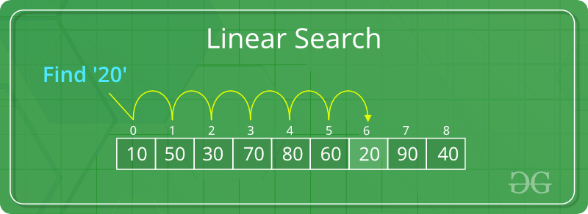
Linear Search

Slide 3
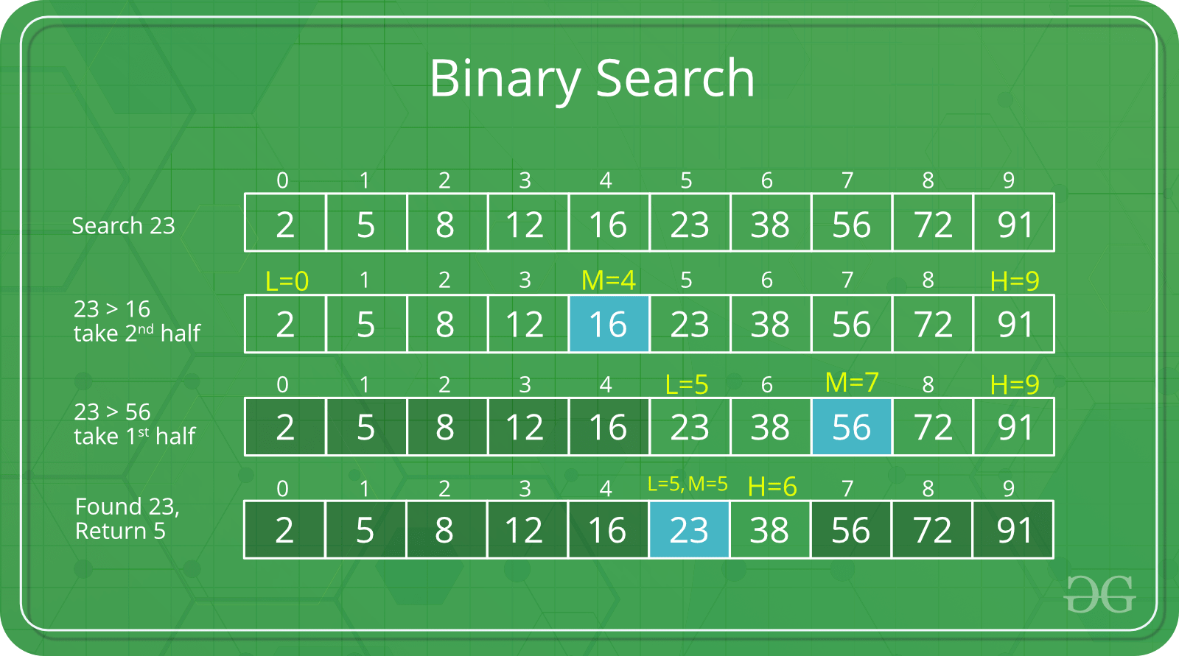
Binary Search

Slide 4
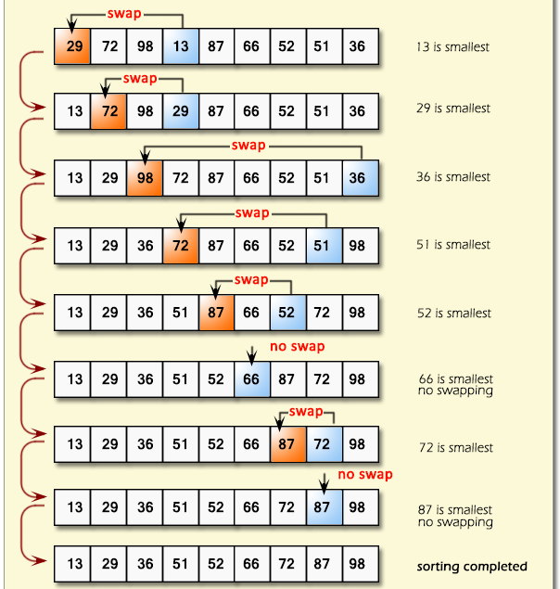
Selection Sort

Slide 5
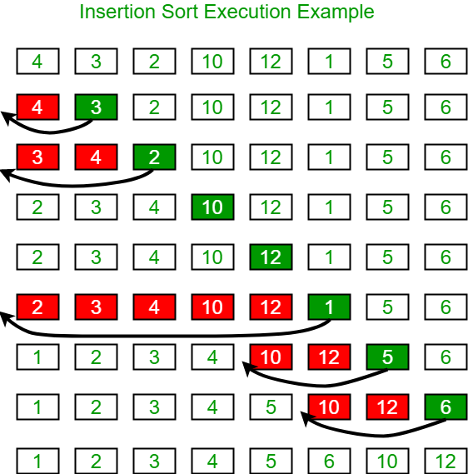
Insertion Sort

Slide 6
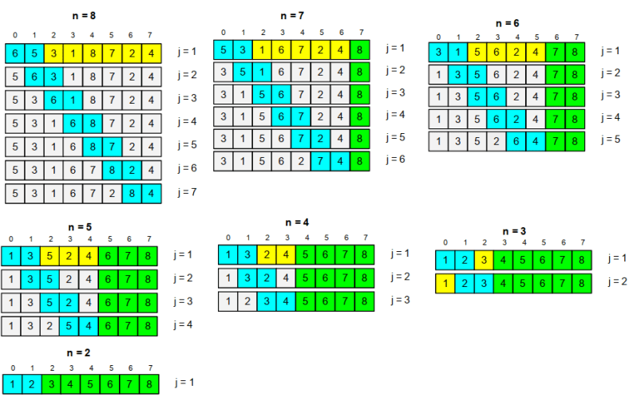
Bubble Sort

Slide 7
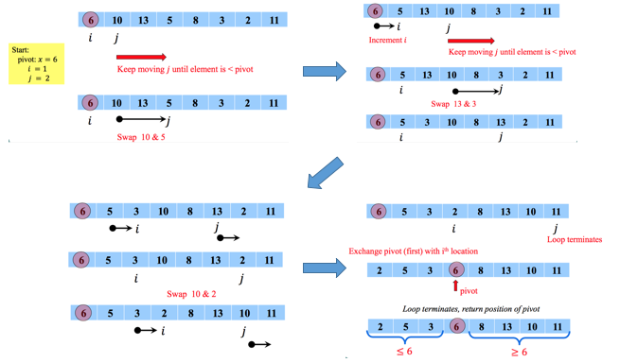
Quick Sort

Slide 8
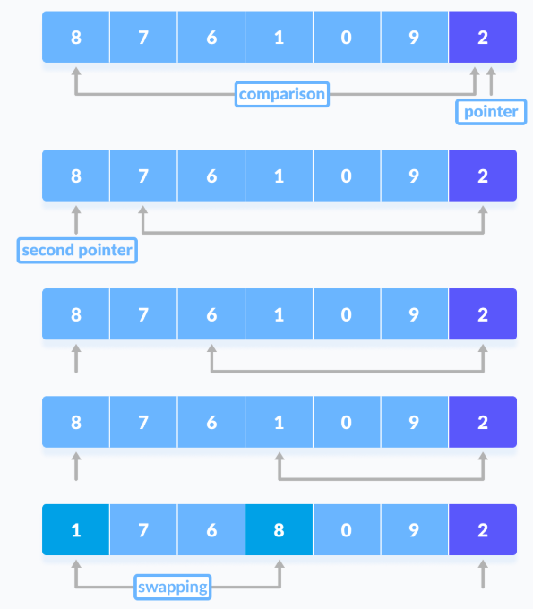
Quick Sort

Slide 9
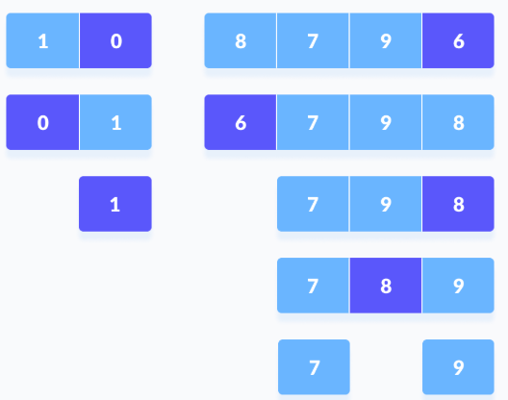
Quick Sort
Quick sort demo : http://me.dt.in.th/page/Quicksort/

Slide 10
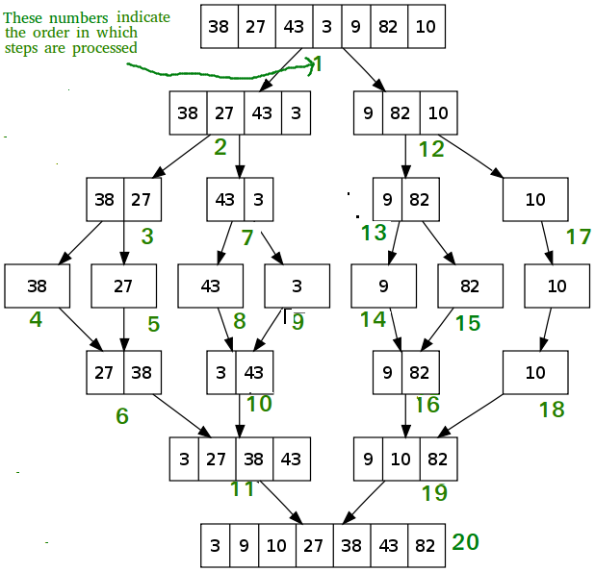
Merge Sort

Slide 11
Merge Sort
lo=0, m=1, hi=3
i1 > m ➔ a[i2]
i2 > hi ➔ a[i1]
a[i1]<a[i2] ➔ a[i1]
a[i1]>a[i2] ➔ a[i2]
a[i1]>a[i2] ➔ a[i2]
a[i1]<a[i2] ➔ a[i1]
6
6
17
17
87
6
22
17
87
6
22
17
87
6
22
i1
i2
i1
i2++
i1
i2++
a[i1]>a[i2] ➔ a[i2]
i2 > hi ➔ a[i1]
6
17
6
17
22
6
17
22
87
17
87
6
22
17
87
6
22
17
87
6
22
i1++
i2++
i1++
(i2++)++
i1++
(i2++)++

Slide 12
Merge Sort
lo=4, m=5, hi=7
i1 > m ➔ a[i2]
i2 > hi ➔ a[i1]
a[i1]<a[i2] ➔ a[i1]
a[i1]>a[i2] ➔ a[i2]
a[i1]<a[i2] ➔ a[i1]
a[i1]>a[i2] ➔ a[i2]
3
3
13
3
41
13
54
3
41
13
54
3
41
13
54
i1
i2
i1++
i2
i1++
i2
a[i1]<a[i2] ➔ a[i1]
i1 > m ➔ a[i2]
3
13
3
13
41
3
13
41
54
3
41
13
54
3
41
13
54
3
41
13
54
i1++
i2++
(i1++)++
i2++
(i1++)++
i2++

Slide 13
Time Complexity
Algorithm Time Complexity
Best Average Worst
Selection Sort Ω(n^2) θ(n^2) O(n^2)
Bubble Sort Ω(n) θ(n^2) O(n^2)
Insertion Sort Ω(n) θ(n^2) O(n^2)
Heap Sort Ω(n log(n)) θ(n log(n)) O(n log(n))
Quick Sort Ω(n log(n)) θ(n log(n)) O(n^2)
Merge Sort Ω(n log(n)) θ(n log(n)) O(n log(n))
Bucket Sort Ω(n+k) θ(n+k) O(n^2)
Radix Sort Ω(nk) θ(nk) O(nk)

Slide 14
Thank You!!

